Slide 1
From the survey -
Less confidence:
Fixed and random effects
Software (SPSS and R)
Pitfalls of analysis, examining assumptions
More confidence:
Understanding reported analyses
Communicating/visualizing results
NHST, basic stats

Slide 2
Plan for today
Complete last week’s lab together
Super quick overview of power analysis concepts
break
Power calculation lab
Discussion of power and sample size justification

Slide 3
Hypothesis Testing: Do’s and Don’ts
Vanessa LoBue
Jamil Bhanji
with a little help from Andy Field

Slide 4
Reminders
Submit your data dictionary - use the “Assignments” submission page
think about how you will organize the data dictionary

Slide 5
Aims
Know what a statistical model is and why we use them
Know what the ‘fit’ of a model is and why it is important.
Distinguish models for samples and populations
Problems with NHST and best practices

Slide 6
The Research Process

Slide 7
Building Statistical Models
Notes:
When we build statistical models, we are trying to model our data to fit with the real world. It can have a good fit or a poor fit, but what we’re hoping for is something in the middle.

Slide 8
Most Important Equation
Notes:
Andy argues the only one you’ll ever need.
Example: number of friends = [teachers’ friends model] + error

Slide 9
A Simple Statistical Model
In Statistics we fit models to our data (i.e. we use a statistical model to represent what is happening in the real world)
The mean is a hypothetical value (i.e. it doesn’t have to be a value that actually exists in the data set)
As such, the mean is simple statistical model
Notes:
One of the simplest models we use in statistics is the mean. Some of you may have trouble thinking of the mean as a model, but in fact it is because it represents a summary of data. The mean is a hypothetical value that can be calculated for any data set, it doesn’t have to be a value that is actually observed in the data set. For example, if we took five statistics lecturers and measured the number of friends that they had, we might find the following data: 1, 3, 4, 3, 2. If we take the mean number of friends, this can be calculated by adding the values we obtained, and dividing by the number of values measured:. Now, we know that it is impossible to have 2.6 friends (unless you chop someone up with a chainsaw and befriend part of their remains, which in practice has proved disturbing) so the mean value is a hypothetical value. As such, the mean is a model that we create to summarise our data.

Slide 10
Measuring the ‘fit’ of the model
The mean is a model of what happens in the real world: the typical score
It is not a perfect representation of the data
How can we assess how well the mean represents reality?

Slide 11
Calculating ‘Error’
A deviation is the difference between the mean and an actual data point.
Deviations can be calculated by taking each score and subtracting the mean from it:

Slide 12
Calculating ‘Error’

Slide 13
Use the Total Error?
We could just take the error between the mean and the data and add them.
Score | Mean | Deviation
1 | 2.6 | -1.6
2 | 2.6 | -0.6
3 | 2.6 | 0.4
3 | 2.6 | 0.4
4 | 2.6 | 1.4
 | Total = | 0

Slide 14
Sum of Squared Errors
We could add the deviations to find out the total error.
Deviations cancel out because some are positive and others negative.
Therefore, we square each deviation.
If we add these squared deviations we get the Sum of Squared Errors (SS).

Slide 15
Sum of Squared Errors
Score | Mean | Deviation | Squared Deviation
1 | 2.6 | -1.6 | 2.56
2 | 2.6 | -0.6 | 0.36
3 | 2.6 | 0.4 | 0.16
3 | 2.6 | 0.4 | 0.16
4 | 2.6 | 1.4 | 1.96
 |  | Total | 5.20

Slide 16
Mean Squared Error
Although the SS is a good measure of the accuracy of our model, it depends on the amount of data collected. To overcome this problem, we use:
Notes:
we use n-1 instead of n because it gives us a better estimate of the population error. n-1 is the degrees of freedom.

Slide 17
Degrees of Freedom
Notes:
After you solve one parameter, what are the combinations of parameters are left
The number of degrees of freedom is the number of values in the final calculation that are free to vary.[
Let’s say
that the mean of the sample was 10 and, therefore, we estimate
that the population mean is also 10. The value of this parameter
is now fixed: we have held one parameter constant.
Imagine we now want to use this sample of four observations to estimate the
mean squared error in the population. To do this, we need to use
the value of the population mean, which we estimated to be the
fixed value of 10. With the mean fixed, are all four scores in our
sample free to be sampled? The answer is no, because to ensure
that the population mean is 10 only three values are free to vary.
For example, if the values in the sample we collected were 8, 9,
11, 12 (mean = 10) then the first value sampled could be any
value from the population, say 9. The second value can also be
any value from the population, say 12. Like our football team,
the third value sampled can also be any value from the
population, say 8. We now have values of 8, 9 and 12 in the
sample. The final value we sample, the final player to turn up to
the soccer game, cannot be any value in the population, it has to
be 11 because this is the value that makes the mean of the
sample equal to 10 (the population parameter that we have held
constant). Therefore, if we hold one parameter constant, then
the degrees of freedom must be one fewer than the number of
scores used to calculate that parameter. This fact explains why
when we use a sample to estimate the mean squared error (or
indeed the standard deviation) of a population, we divide the
sums of squares by N − 1 rather than N alone. There is a
lengthier explanation in one of my other books

Slide 18
The Standard Error
SD tells us how well the mean represents the sample data
But, if we want to estimate this parameter in the population, then we need to know how well the mean represents the population

Slide 19
Populations and Samples
Population
The collection of units (be they people, plankton, plants, cities, suicidal authors, etc.) to which we want to generalize a set of findings or a statistical model
Sample
A smaller (but hopefully representative) collection of units from a population used to determine truths about that population

Slide 20
Populations and Samples
Sample
Mean and SD describe only the sample from which they were calculated
Population
Mean and SD are intended to describe the entire population (very rare in Psychology)
Sample to population:
Mean and SD are obtained from a sample, but are used to estimate the mean and SD of the population (very common in psychology)

Slide 21
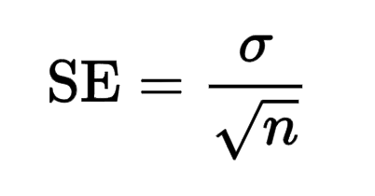
The Standard Error
SD tells us how well the mean represents the sample data
SE tells us how far the sample mean is likely to be from the true population mean
Notes:
The standard deviation (SD) measures the amount of variability, or dispersion, from the individual data values to the mean, while the standard error of the mean (SEM) measures how far the sample mean (average) of the data is likely to be from the true population mean
The standard error is the SD over the square root of the sample. The SE gets smaller as your sample gets bigger.
This makes sense, because the mean of a large sample is likely to be closer to the true population mean than is the mean of a small sample. ... The SD does not change predictably as you acquire more data.

Slide 22
Hypothesis Testing
Null hypothesis, H0
There is no effect.
E.g. Big Brother contestants and members of the public will not differ in their scores on personality disorder questionnaires
The alternative hypothesis, H1
AKA the experimental hypothesis
E.g. Big Brother contestants will score higher on personality disorder questionnaires than members of the public

Slide 23
Test Statistics
A Statistic for which the frequency (distribution) of values is known.
Observed values can be used to test hypotheses.
Notes:
A test statistic is a random variable that is calculated from sample data and used in a hypothesis test. You can use test statistics to determine whether to reject the null hypothesis. The test statistic compares your data with what is expected under the null hypothesis. The test statistic is used to calculate the p-value.

Slide 24
Reproducibility Issues
Notes:
But there are problems with test statistics.

Slide 25
NHST and wider problems in science
Incentive structures and publication bias
Researcher degrees of freedom
p-hacking and HARKing

Slide 26
Incentive Structures
File drawer effect—null results don’t get published
Shrinking job market
High impact journals favor “flashy” findings

Slide 27
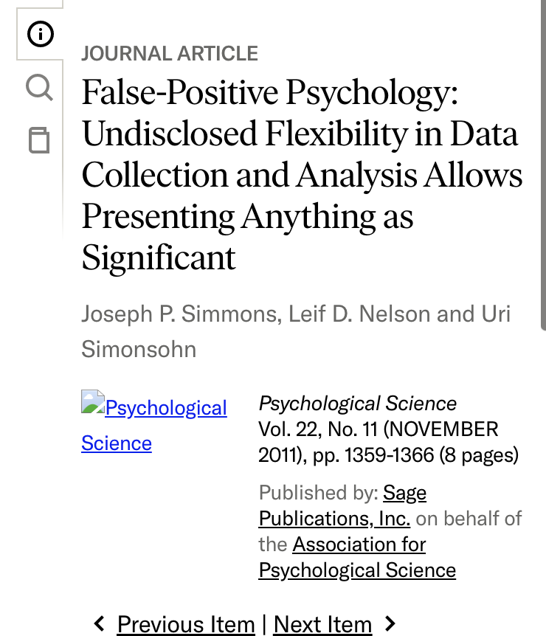
“Researcher degrees of freedom”
A scientist has many decisions to make when designing and analysing a study.
The alpha level, the level of power, how many participants should be collected, which statistical model to fit, how to deal with extreme scores, which control variables to consider, which measures to use, and so on
Researchers might use these researcher degrees of freedom to shed their results in the most favourable light

Slide 28
p-hacking
p-hacking—researcher degrees of freedoms that lead to the selective reporting of significant p-values
Trying multiple analyses/measuring multiple outcomes but reporting only the significant results
Stopping data collection at a point other than when the pre-determined sample size is reached
Including (or not) data based on the effect they have on the p-value

Slide 29
p-hacking
p-hacking—researcher degrees of freedoms that lead to the selective reporting of significant p-values
Including (or excluding) variables in an analysis based on how those variables affect the p-value
Merging groups of variables or scores to yield significant results
Transforming, or otherwise manipulating scores to yield significant p-values

Slide 30
HARKing
HARKing
The practice in research articles of presenting a hypothesis that was made after data collection as though it were made before data collection
Notes:
example: We observed that Big brother contestants are actually lower on personality disorder questionnaires compared to non-contestants, so we change the hypothesis to say we always expected that outcome because Big Brother contestants are actually selected for their exceptional social intelligence.

Slide 31
Throw Away NHST?
Notes:
With all of these problems, do we just throw null hypothesis testing away?

Slide 32
Throw Away NHST?
“I do not think that it is useful to tell researchers what they want to know. Instead, we should teach them the possible questions they can ask…Unless we examine which questions researchers ask, depending on the goals they have when they perform a study, the phase of the research line, the knowledge that already exists on the topic, and the philosophy of science that researchers subscribe to, it is impossible to draw conclusions about the statistical approach that gives the most useful answer.” Lakens (2021)
Notes:
in NHST we are always testing the probability of the data given the hypothesis (that is, the probability of a parameter this extreme if the null hypothesis is true. this approach does not directly address the probability of the hypothesis – so researchers must understand this and adjust their interpretations appropriately.

Slide 33
Misconceptions around p-values
Misconception 1: A significant result means that the effect is important
No, because significance depends on sample size.
Misconception 2: A non-significant result means that the null hypothesis is true
No, a non-significant result tells us only that the effect is not big enough to be found (given our sample size), it doesn’t tell us that the effect size is zero.
Misconception 3: A significant result means that the null hypothesis is false?
No, it is logically not possible to conclude this.

Slide 34
Avoid All-or-Nothing Thinking
Notes:
nothing magic about the criterion of p < 0.05, it is merely a convenient rule of thumb that has become popular for arbitrary reasons.
in the chart, all-or-nothing thinking would lead us to conclude what? (only 4 out of 10 were significant) - but actually there is consistency in the results. leads into many labs study

Slide 35
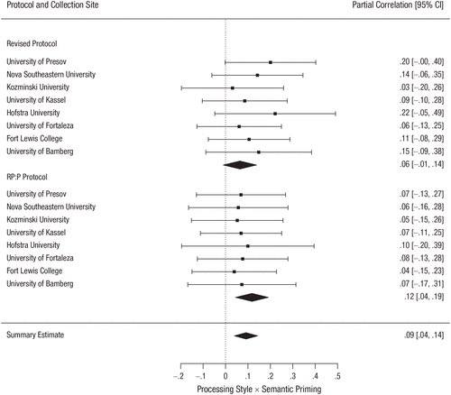
ManyLabs 5
Notes:
Remember Misconception 2: A non-significant result means that the null hypothesis is true
No, a non-significant result tells us only that the effect is not big enough to be found (given our sample size), it doesn’t tell us that the effect size is zero.
this was a replication of effect of aggression primes

Slide 36
Power
Type I error
Occurs when we believe that there is a genuine effect in our population, when in fact there isn’t.
The probability is the α-level (usually 0.05)
Type II error
Occurs when we believe that there is no effect in the population when, in reality, there is.
The probability is the β-level (often 0.2)
Notes:
We can be better. Use power analyses.

Slide 37
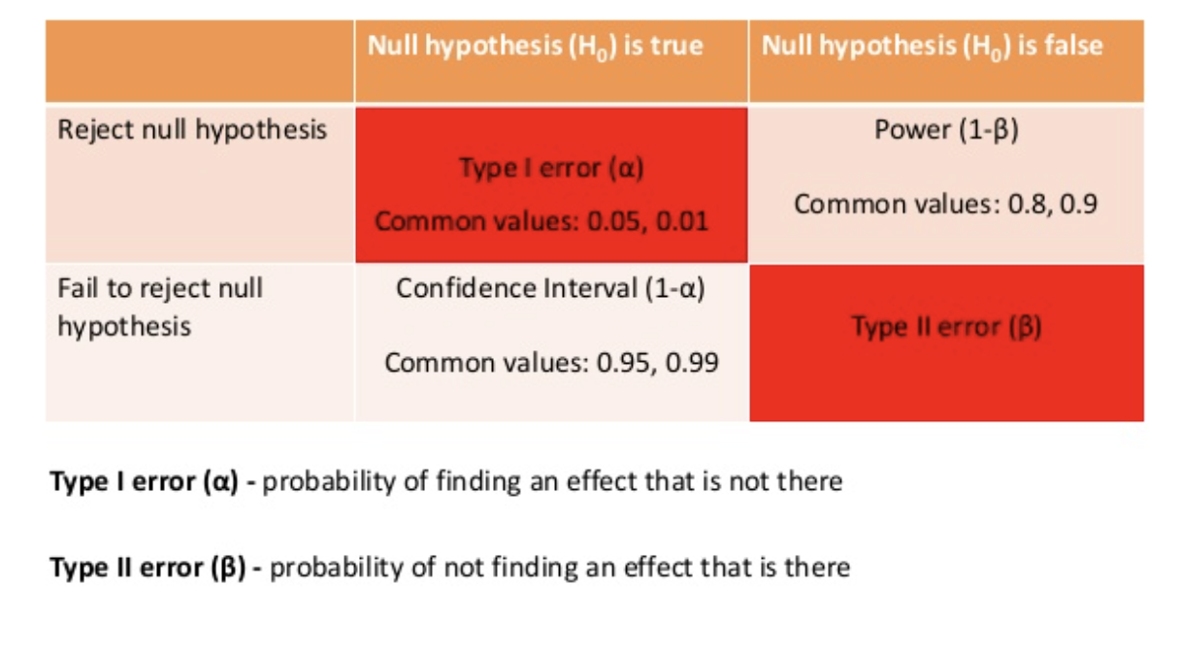
Power
Notes:
Probability of correctly rejecting the null
Cohen recommends .8

Slide 38
Showing Confidence Intervals Visually
Notes:
Also report CI’s. The 95% confidence interval is a range of values that you can be 95% confident contains the true mean of the population.

Slide 39
Confidence intervals and statistical significance
Notes:
Cumming & Finch (2005) have three guidelines that are shown in the figure:
95% confidence intervals that just about touch end-to-end (as in the top left panel) represent a p-value for testing the null hypothesis of no differences of approximately 0.01.
If there is a gap between the upper end of one 95% confidence interval and the lower end of another (as in the top right panel of Figure 2.16), then p < 0.01.
A p-value of 0.05 is represented by moderate overlap between the bars (the bottom panels). What do we mean by moderate overlap? Cumming (2012) defines it as half the length of the average margin of error (MOE). The MOE is half the length of the confidence interval (assuming it is symmetric)

Slide 40
Report Effect sizes
An effect size is a standardized measure of the size of an effect:
Standardized = comparable across studies
Not (as) reliant on the sample size
Allows people to objectively evaluate the size of observed effect.
They encourage interpreting effects on a continuum and not applying a categorical decision rule such as ‘significant’ or ‘not significant’
Notes:
p-value is not an effect size. t stat is not an effect size. these are both highly dependent on sample size.

Slide 41
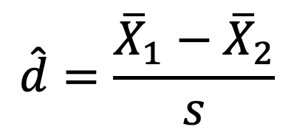
Effect Size Measures
There are several effect size measures that can be used:
Cohen’s d
Pearson’s r
Odds Ratio/Risk rates
$$\hat{d}=\frac{{\overline{X}}_{1}−{\overline{X}}_{2}}{s}$$
Notes:
To calculate the standardized mean difference between two groups, subtract the mean of one group from the other (M1 – M2) and divide the result by the standard deviation (SD) of the population from which the groups were sampled. In this case one of the groups (usually the control)

Slide 42
Effect Size Measures
r = .1, d = .2 (small effect):
the effect explains 1% of the total variance.
r = .3, d = .5 (medium effect):
the effect accounts for 9% of the total variance.
r = .5, d = .8 (large effect):
the effect accounts for 25% of the variance.
Beware of these ‘canned’ effect sizes though:
The size of effect should be placed within the research context.

Slide 43
Preregistration
Pre-registration of research
The practice of making all aspects of your research process (rationale, hypotheses, design, data processing strategy, data analysis strategy) publicly available before data collection begins
Registered reports in an academic journal
If the protocol is deemed to be rigorous enough and the research question novel enough, the protocol is accepted by the journal typically with a guarantee to publish the findings no matter what they are
Public websites (e.g., the Open Science Framework, AsPredicted)

Slide 44
Best Practices
The ASA statement on p-values (Wasserstein & American Statistical Association, 2016).
The ASA points out that p-values can indicate how incompatible the data are with a specified statistical model (e.g., how incompatible the data are with the null hypothesis. You are at liberty to use the degree of incompatibility to inform your own beliefs about the relative plausibility of the null and alternative hypotheses, as long as you don’t interpret p-values as a measure of the probability that the hypothesis in question is true. They are also not the probability that the data were produced by random chance alone.
Scientific conclusions and policy decisions should not be based only on whether a p-value passes a specific threshold.
Notes:
Ronald Wasserstein is the executive director of the ASA

Slide 45
Best Practices
The ASA statement on p-values (Wasserstein & American Statistical Association, 2016).
Don’t p-hack. Be fully transparent about the number of hypotheses explored during the study, and all data collection decisions and statistical analyses.
Don’t confuse statistical significance with practical importance. A p-value does not measure the size of an effect and is influenced by the sample size, so you should never interpret a p-value in any way that implies that it quantifies the size or importance of an effect.
‘By itself, a p-value does not provide a good measure of evidence regarding a model or hypothesis.’

Slide 46
Why make your work reproducible?
Avoid making mistakes!
Easier to write up results
Helps reviewers see it your way
Easier to remember what you did (continuity of your work)
Helps build your reputation

Slide 47
Aims
Know what a statistical model is and why we use them
Know what the ‘fit’ of a model is and why it is important.
Distinguish models for samples and populations
Problems with NHST and best practices

